Slide 1
Cutting through the noise approaches
Phrase Automatic Speech Recognition
System utilising incremental ASR solutions (STT - TTS)
InproTK, Google Cloud STT, DeepSpeech, CMUSphinx (pocketsphinx)
Emotive Evolving Method (‘Social Mixer’)
System utilising ML weights to feedback to audio mixer
Training/test data RAVDESS
Emotive ‘Noise Suppression’
System utilising ML to automatically remove negative emotional activity in voice channel
Training/test data RAVDESS

Slide 2
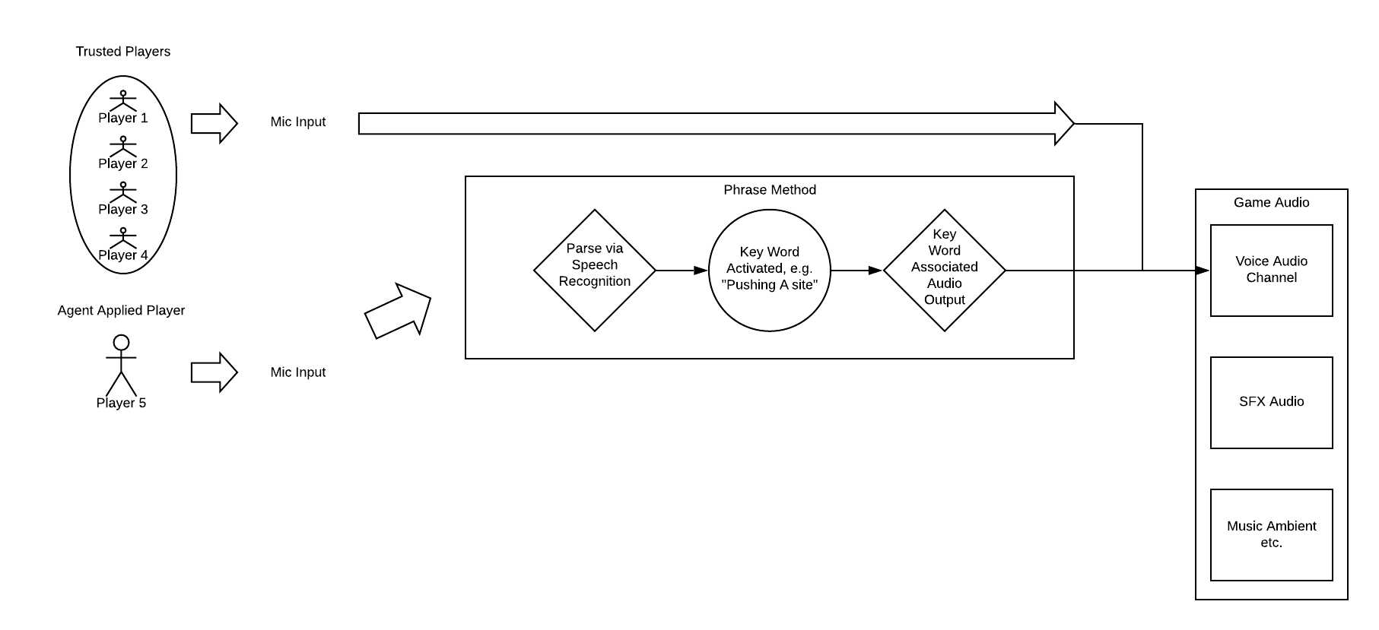
Cutting through the noise approaches
Speech-to-text then TTS appears to be the best solution, allowing intermediate results to be polled during continuous mic input. Open-source solutions available.
Computationally heavy, unreliable from available examples.

Slide 3
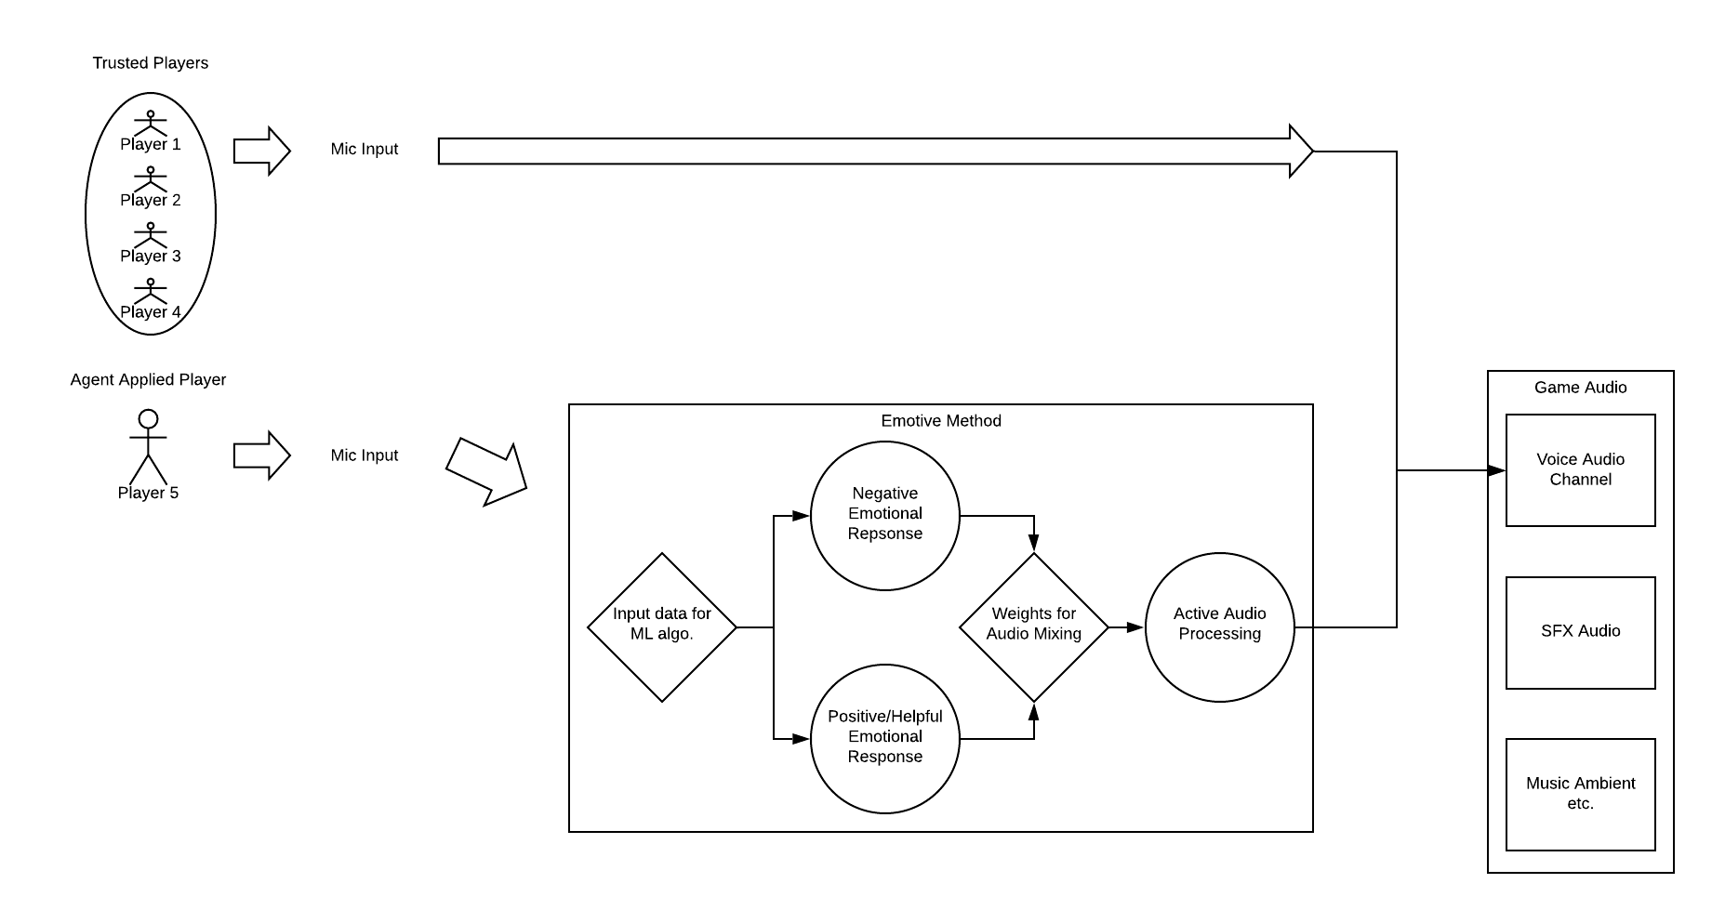
Cutting through the noise approaches cont.
Utilising RAVDESS dataset, requires implementation of multiple solutions to achieve end-to-end
ML tells us the content, that data is used in order to detail/design mix of voice channel audio

Slide 4
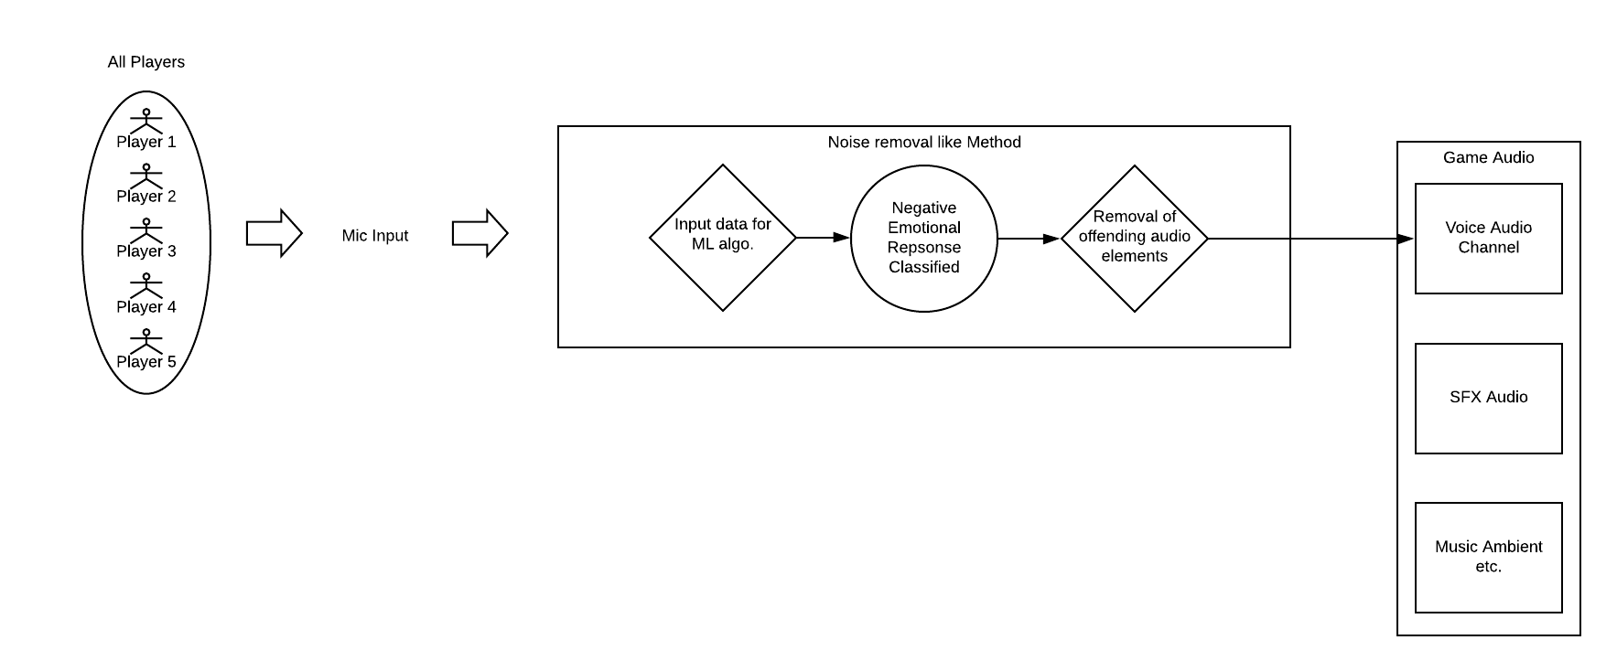
Cutting through the noise approaches cont.
Approach similar to common noise removal methods. Using RAVDESS dataset, manually combine audio in pseudo-conversational manner for training, samples with and without negative emotional responses. Allows for automatic removal of negative discourse.

Slide 5
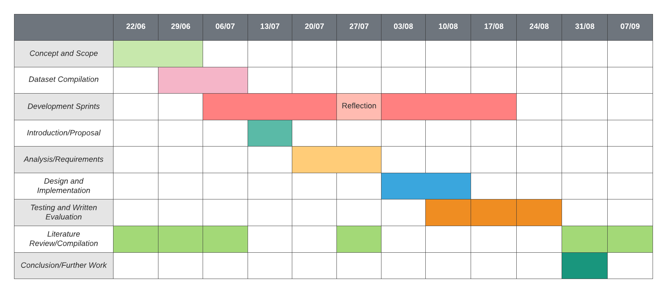
Project Planning Outline

Slide 6
Questions & Points for discussion
Is it possible to get access to data fundamentals course materials?
Due to latency related issues, generalise to all games where some latency is acceptable (a few seconds), working towards competitive games in the future.
Selecting a system to pursue, what might be easiest to implement without fully compromising main aims - but provides a developmental project!

